Slide 1
1st Generation Pencil and Tablet

Slide 2
2nd Generation Excel Tablet

Slide 3
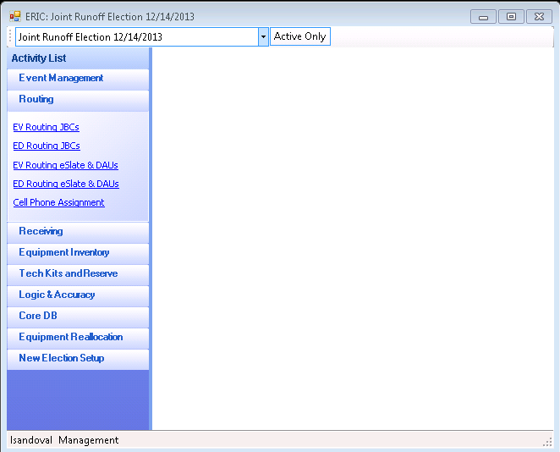
3rd Generation SEQUEL Database

Slide 4
Business Rules Election Routing and Inventory Control (ERIC)
Inventory
Tracking
Chain of Custody
Election History
Maintenance History

Slide 5
Inventory
Acceptance Testing On All Equipment Before Adding to Inventory

Slide 6
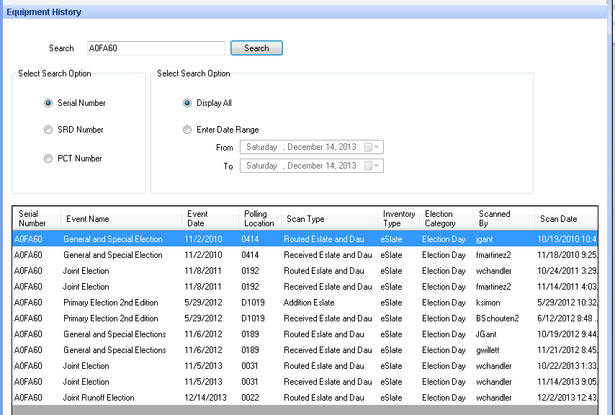
Tracking
Knowing Where Equipment Is Located At All Times

Slide 7
JBC Chain of Custody
Inventory
Configuration
Supply Handout
Judge Accepts Equipment
Equipment is located at Polling Location
Election Night Drop Off
Received

Slide 8
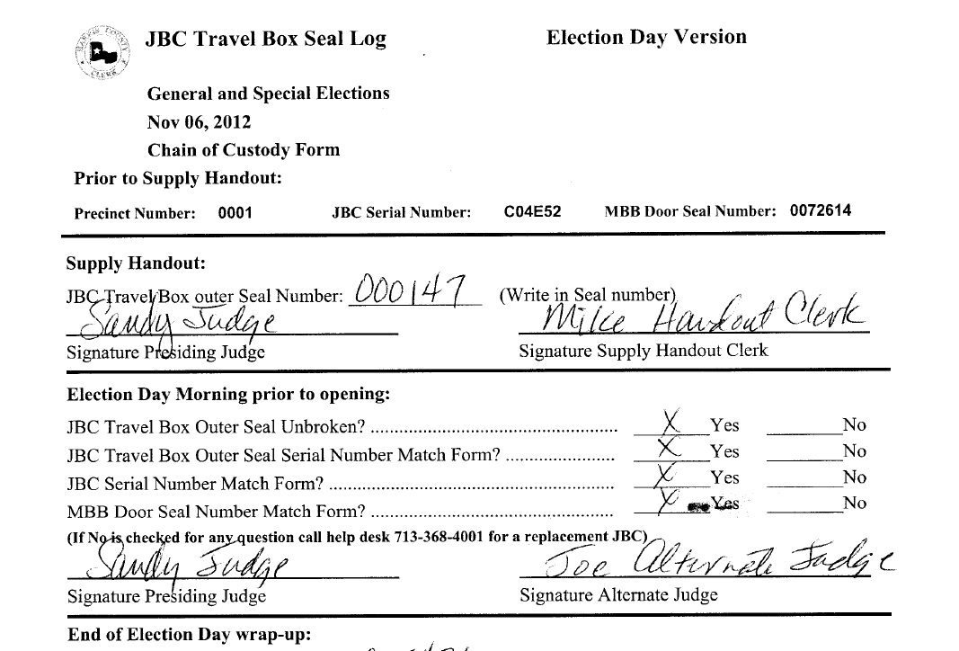
JBC Election Day Chain of Custody Form

Slide 9
eSlate Chain of Custody
Inventory
Configuration
Routed
Delivered to Assigned Location
Equipment is Picked Up
Returned to ETC
Received

Slide 10
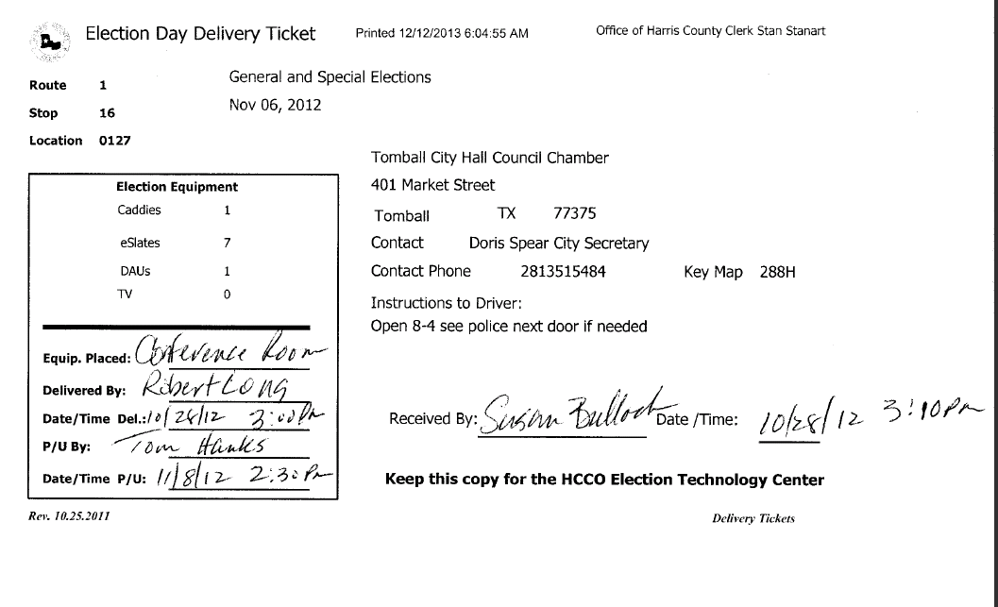
Delivery and Pickup

Slide 11
MBB Chain of Custody
Inventory
Event Inventory
Assign to Departments
ETC Pairs MBB to JBC
Judges Pickup JBC’s
Returned to Drop Off Location
Returned to Central Count and Quarantined
Received

Slide 12
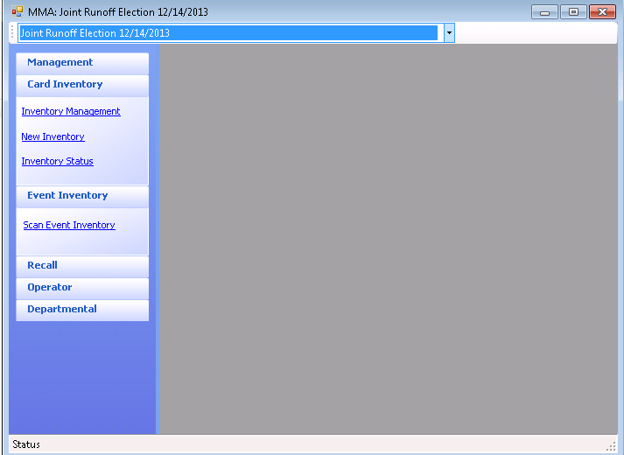
MBB Management Application (MMA)

Slide 13
MBB Tracking Across Multiple Platforms
MBB Management Application Utilization log & Inventory
MBB Utilization Log demonstrates how the MBB follows the Chain of Custody as it used throughout the Election Process.
MBB traced back to the inventory as being in use –
until is received in the Utilization Log.
ERIC Utilization Log – demonstrates how the MBB
HCE3928 is assigned to JBC C04FEC.
ERIC sends Precinct or SRD information to the MBB Management as it is pairs a JBC with an MBB.
ERIC Utilization Log

Slide 14
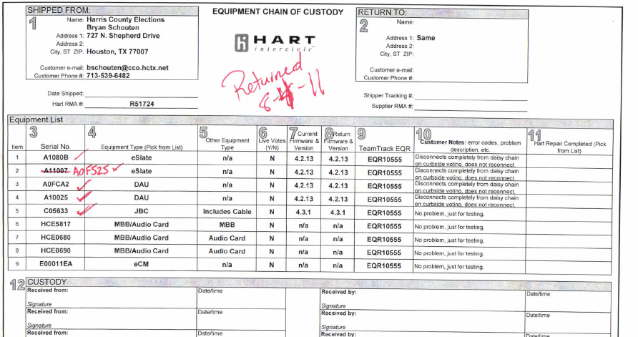
Equipment Maintenance
ETC Maintenance
Sent to Hart for Repair

Slide 15
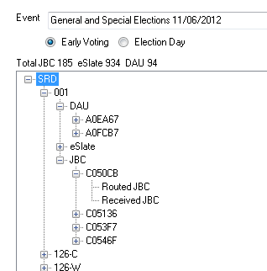
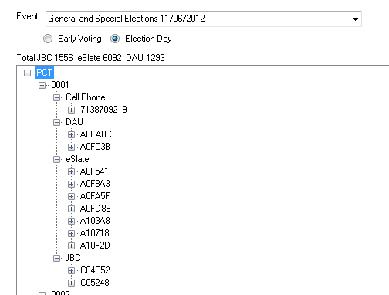
Election History
Early Voting
Election Day

Slide 16
Beyond the Business Rules Benefits
Routing
Delivery Tickets in Route, Stop Order
Trouble Shooting Logs
Report Replacements
Report Equipment in need of repair
Budget
History
Route Summary in Route, Stop Order
Projections
Program Income

Slide 17
Routing

Slide 18
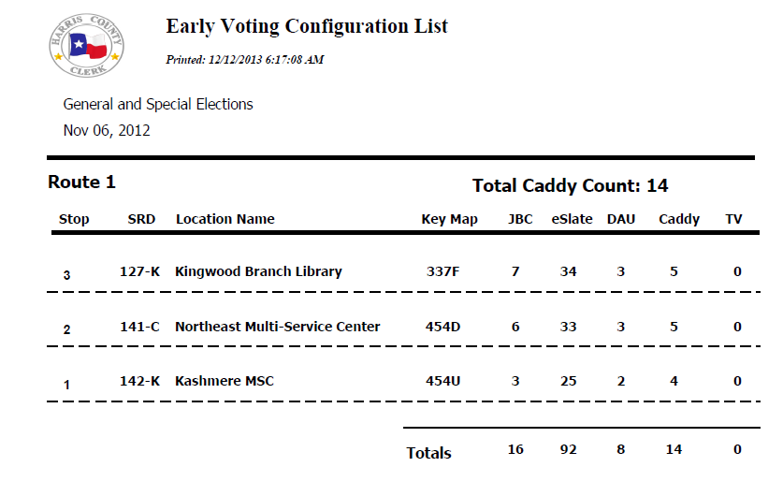
Early Voting Configuration List

Slide 19
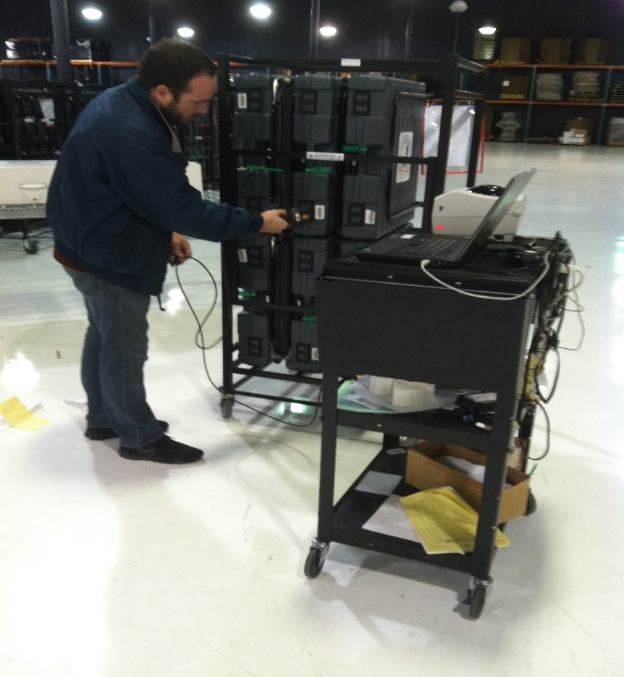
Scanning Equipment
JBC’s
eSlate’s and DAU’s

Slide 20
Supply Handout
Prepping the Floor
Judges Pickup JBC’s and Supplies

Slide 21
Ballot & Seal Certificate

Slide 22
Early Voting Ballot Board

Slide 23
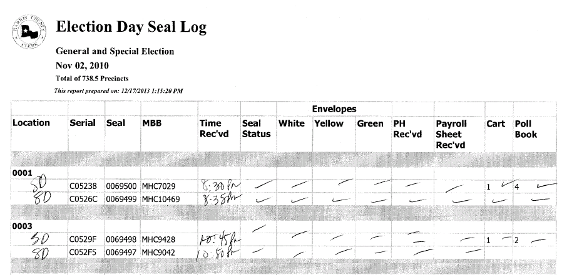
Reporting Election Day Seal Log

Slide 24
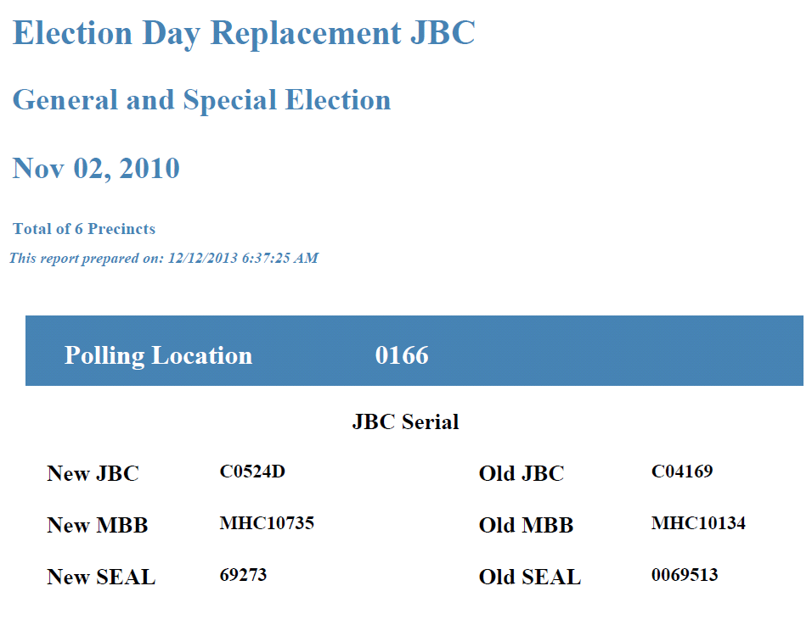
Reporting JBC Replacement Log

Slide 25
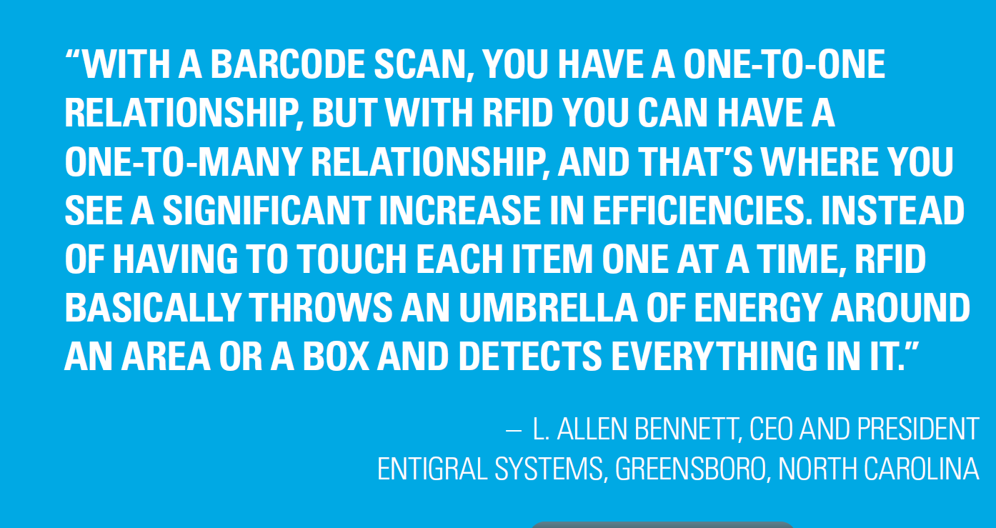
4th Generation Radio Frequency Identification Device RFID

Slide 26
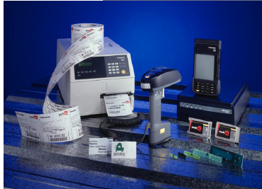
RFID systems are easy to set up in lab settings yet they take more planning and testing to set up in real-world applications.

Slide 27
RFID readers at loading dock doors create a magnetic field that RFID tags pass through.

Slide 28
RFID would eliminate this station or step
JBC’s
eSlate’s and DAU’s

